Slide 1
Chapter 3: Introduction to SQL
Notes:
1
All concept first start with the example…

Slide 2
Chapter 3: Introduction to SQL
Overview of the SQL Query Language
Data Definition
Basic Query Structure
Additional Basic Operations
Set Operations
Null Values
Aggregate Functions
Nested Subqueries
Modification of the Database
Notes:
2
1

Slide 3
History
IBM Sequel language developed as part of System R project at the IBM San Jose Research Laboratory
Renamed Structured Query Language (SQL)
ANSI and ISO standard SQL:
SQL-86, SQL-89, SQL-92
SQL:1999, SQL:2003, SQL:2008
Commercial systems offer most, if not all, SQL-92 features, plus varying feature sets from later standards and special proprietary features.
Not all examples here may work on your particular system.
Notes:
3
Both ANSI and the ISO have accepted SQL as the standard language for relational databases
American National Standards Institute (ANSI) and the International Organization for Standardization (ISO),

Slide 4
Data Definition Language
The SQL data-definition language (DDL) allows the specification of information about relations, including:
The schema for each relation.
The domain of values associated with each attribute.
Integrity constraints
And as we will see later, also other information such as
The set of indices to be maintained for each relations.
Security and authorization information for each relation.
The physical storage structure of each relation on disk.
Notes:
4

Slide 5
Basic Types in SQL
char(n). Fixed length character string, with user-specified length n.
varchar(n). Variable length character strings, with user-specified maximum length n.
int. Integer (a finite subset of the integers that is machine-dependent).
smallint. Small integer (a machine-dependent subset of the integer domain type).
numeric(p,d). Fixed point number, with user-specified precision of ‘p’ digits, with ‘d’ digits to the right of decimal point.
real, double precision. Floating point and double-precision floating point numbers, with machine-dependent precision.
float(n). Floating point number, with user-specified precision of at least n digits.
Notes:
5

Slide 6
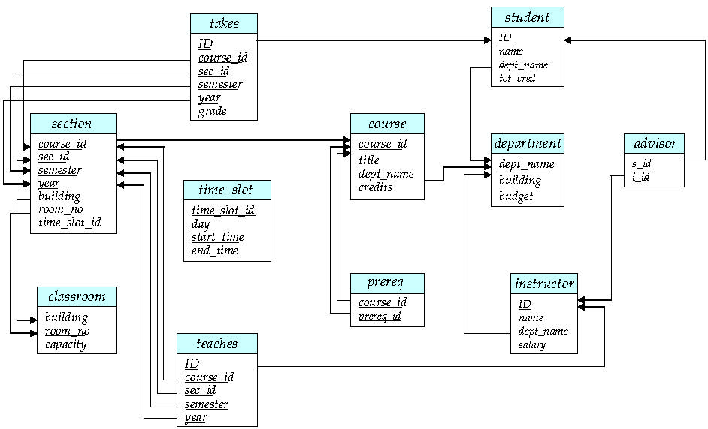
Schema Diagram for University Database

Slide 7
Create Table Construct
An SQL relation is defined using the create table command:
create table r (A₁ D₁, A₂ D₂, ..., A_{n} D_{n}, (integrity-constraint₁), ..., (integrity-constraint_{k}))
r is the name of the relation
each A_{i} is an attribute name in the schema of relation r
D_{i} is the data type of values in the domain of attribute A_{i}
Example:
create table instructor ( ID char(5), name varchar(20) not null, dept_name varchar(20), salary numeric(8,2))
Notes:
7

Slide 8
Integrity Constraints in Create Table
not null
primary key (A₁, ..., A_{n} )
foreign key (A_{m}, ..., A_{n} ) references r
Example: Declare ID as the primary key for instructor
.
create table instructor ( ID char(5), name varchar(20) not null, dept_name varchar(20), salary numeric(8,2), primary key (ID), foreign key (dept_name) references department)
primary key declaration on an attribute automatically ensures not null
Notes:
8

Slide 9
Class work

Slide 10
Schema Diagram for University Database

Slide 11
for Work out

Slide 12
And a Few More Relation Definitions
create table student ( ID varchar(5), name varchar(20) not null, dept_name varchar(20), tot_cred numeric(3,0), primary key (ID), foreign key (dept_name) references department );
create table takes ( ID varchar(5), course_id varchar(8), sec_id varchar(8), semester varchar(6), year numeric(4,0), grade varchar(2), primary key (ID, course_id, sec_id, semester, year), foreign key (ID) references student, foreign key (course_id, sec_id, semester, year) references section );
Note: sec_id can be dropped from primary key above, to ensure a student cannot be registered for two sections of the same course in the same semester

Slide 13
And still more
create table course ( course_id varchar(8) primary key, title varchar(50), dept_name varchar(20), credits numeric(2,0), foreign key (dept_name) references department) );
Primary key declaration can be combined with attribute declaration as shown above

Slide 14
Changes to the table
insert into instructor values (‘10211’, ’Smith’, ’Biology’, 66000);
drop table student
Deletes the table and its contents
delete from student [where conditions];
Deletes all contents of table, but retains table
alter table
alter table r add A D
where A is the name of the attribute to be added to relation r and D is the domain of A.
All tuples in the relation are assigned null as the value for the new attribute.
alter table r drop A
where A is the name of an attribute of relation r
Dropping of attributes not supported by many databases
Notes:
14
To alter constraints: alter table r add constraint chk_no check (gender in (‘F’,’M’) )
alter table r drop constraint che_no;
alter table r add constraint PK_name primary key (RegNo) ;
alter table r modify PAN int(6) not null;

Slide 15
Drop and Alter Table Constructs
alter table
Alter table table_Name Modify Col_Name datatype constraint(s)
Alter table r modify A D C(s)
where A is the name of the attribute to be added to relation r and D is the domain of A.
Notes:
15
To alter constraints: alter table r add constraint chk_no check (gender in (‘F’,’M’) )
alter table r drop constraint che_no;
alter table r add constraint PK_name primary key (RegNo) ;
alter table r modify PAN int(6) not null;

Slide 16
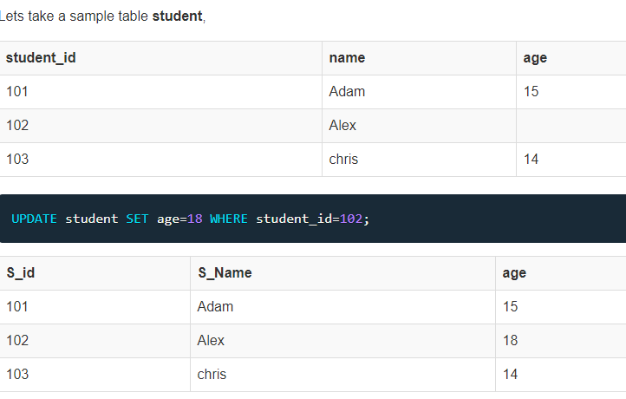
Update the contents
UPDATE table_name SET column_name = new_value WHERE some_condition;

